Slide 1

Time for Innovation in Health Insurance ?

Slide 2
The GCC Health – Is there an Issue ?

Slide 3
Cost of HealthCare - GCC

Slide 4
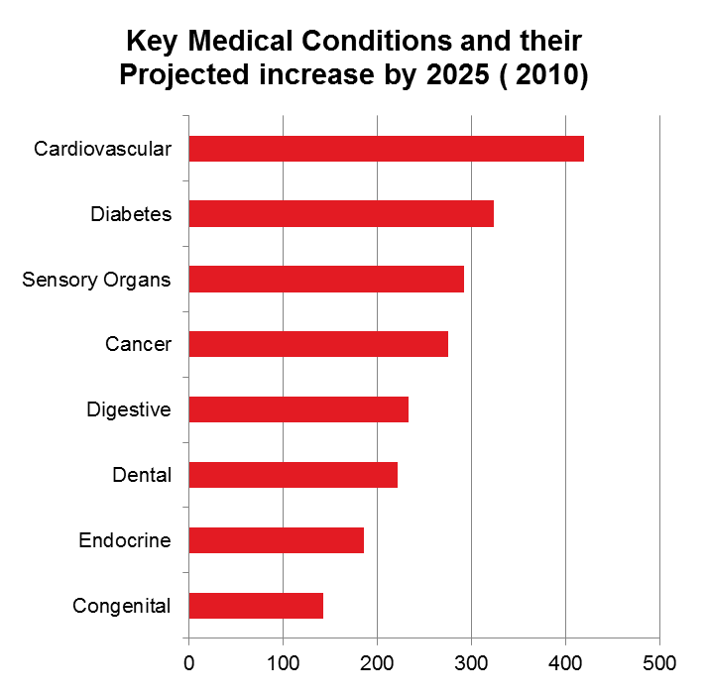
Key Cost Drivers

Slide 5
Key Cost Drivers - Cancer Burden GCC: Projected increase in Cancer 2012 - 2030

Slide 6
Health risks increase health costs
  Depressed have 70% higher annual health plan costs.
  Stressed have 46% higher annual health plan costs.
  Elevated blood sugar have 35% higher annual health plan costs.
  Obesity have 21% higher annual health plan costs.
  Smokers have 20% higher annual health plan costs.
  High Blood pressure have 12% higher annual health plan costs.
  Not exercising have 10% higher annual health plan costs.
Source: Goetzel RZ, et.al . The relationship between modifiable health risks and health care expenditures: An analysis of the multi-employer HERO health risk and cost database JOEM, 40(10):843-54.

Slide 7
Economic Impact
Rising Costs
Low HC Expenditure as a % of GDP
Incentivized Private Sector
Source: Sigma/ WHO/ Alpen/ Mckinsey/AXCO Reports

Slide 8
AGING AND DISEASE MIX ARE DRIVING RISING COSTS GLOBALLY…
Aging populations
A shift towards chronic disease
World population
Millions by age
World deaths
Millions, percent
10,000
50
57
58
63
73
21%
≥ 60
Injuries
9
9
9
10
10
0.3
8,000
Commun-icable*
-1.1
6,000
10%
4,000
60%
59%
15 - 59
Chronic
58
59
61
65
69
0.4
2,000
0 - 14
30%
20%
0
2000
2050
1990
2002*
2005**
2015**
2030**
Note: All WHO countries with private medical expenditures above USD 5 bn
* Includes communicable, maternal, perinatal, and nutritional conditions
Source: WHO Core Health Indicators, ICP Global Results, EIU, McKinsey analysis

Slide 9




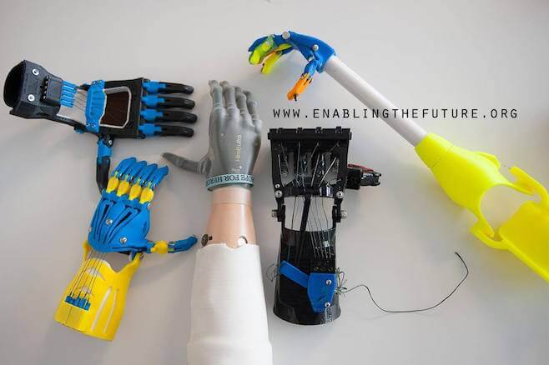

Cost of Care - Medical Innovations
Health Sensors
Augmented & Virtual Reality
Genomics
Gamifying Health
Telemedicine
Surgical Robots
Empowered Patients
Artificial Intelligence
DIY Biotechnology
3D Printing Revolution
Growing Organs in Labs
Cryonics & Longevity
Portable Diagnostics
Prosthetics
Nanotechnology

Slide 10
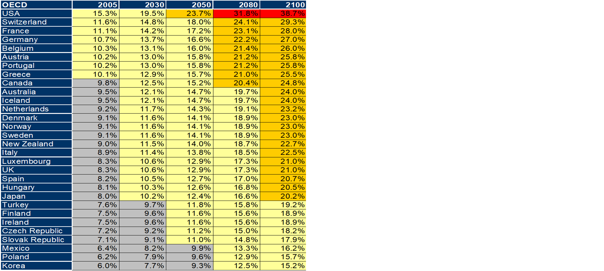
. . . All OF WHICH COULD RESULT IN HEALTHCARE SPEND CONSUMING DISPROPORTIONATE AMOUNTS OF GDP IF SYSTEMS GO UNCHANGED
Source: Forecast model assuming real GDP growth of 2.0%, health care spending growing at 0.95/1.9 percentage
points above; OECD Policy Implications of the New Economy 2000 - 2050 (2001);
Global Insight WMM 2000 - 2037

Slide 11
GCC Health Insurance Market
Source: SAMA/AXCO/Alpen Capital /IA-UAE/CBB Reports/CMA Reports

Slide 12
Health Service Providers GCC – Performance of Listed Providers

Slide 13


Slide 14

What is Innovation?
“The greatest discovery comes not from seeing the new landscapes but in seeing the familiar with new eyes”
Marcel Proust

Slide 15
Innovation – Our Major Reactions

Slide 16
Major Reactions
Deductibles
Co Payments
Exclusions
Increased Premiums
Alternative Payment Mechanisms
Underwrite
Retrospective/Reactive Management
Administrative Digitization
Working in Isolation

Slide 17
Innovation through Behavioral Changes

Slide 18
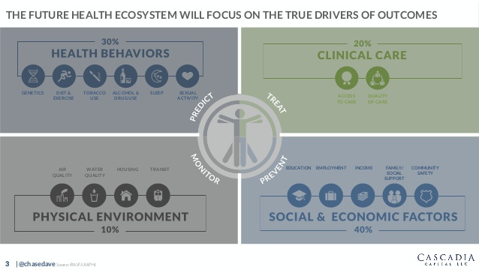
Patient Engagement
Remote Patient Monitoring
Care Access
Disease Management
Personalized Medicine
Health Information Decision Making Tools
Wearables
Health Coaching
Wellness Programs
Family Support
Incentive Programs
Early Identification and Prevention
HealthCare Expenses Mx
Community Based Health Initiatives
Virtual Medicine
Wellness Program
House Calls
Ageing and End of Life Programs
Healthy Behavior & Social Factors will be a Key Driver of Outcome

Slide 19
Innovation through Disruption

Slide 20


The Current Health Service Delivery System
Issues with the Current System
Visiting Hospital has become a way of Life. Family Physician and Home Visits not adequately promoted.
Contagious growth of “for profit” private health sector;
Miserly increase of government expenditure on healthcare, and
Rising cost of medical care.
US spend on health nearing 20% of GDP, UK 11%. Older population and people living longer with chronic disease has put stressors on both outpatient and step down care facilities in particular
Fraud; abuse and waste by medical service providers, in particular on health insured patients,
Medical service providers have developed their business plans around initiatives for increasing patient footfalls; over prescriptions (medications and diagnostics); maximizing on acute medical care and ensuring bed occupancy is between 80-100%, while
Physicians are incentivized to achieve their KPI, both by the service provider and the pharmaceutical industry.
Poor Patient Physician Engagement
Poor Incentives for Good Health; Prevention; Lifestyle changes
Increasing prevalence of non-communicable diseases
Health and Treatment Outcomes not adequately Measured or Reported
TIME FOR DISRUPTION ??

Slide 21
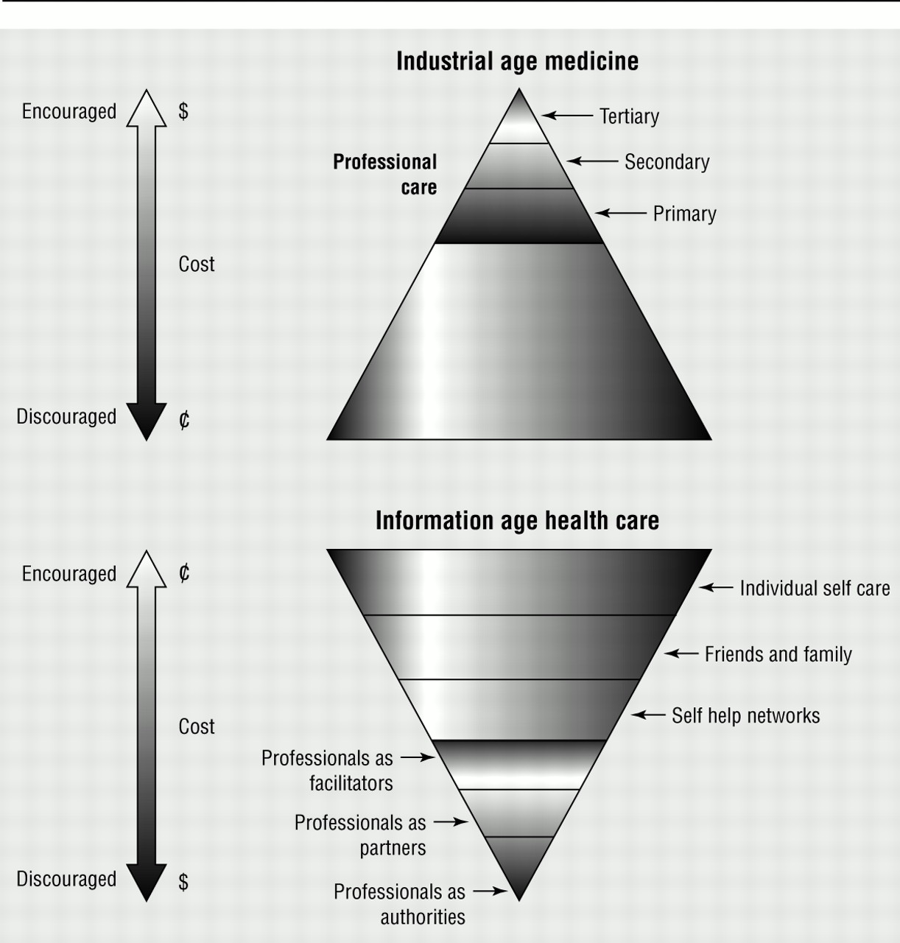
Key Transformation Strategy

Slide 22
Innovation on the Continuum of Care

Slide 23










Continuum of Care.. from
COMPLICATIONS
CLÍNICAL STAGE
DISABILITY
HEALTH
DISEASE
PALLIATIVE CARE
REHABILITATION
DIAGNOSIS & TREATMENT
HEALTH
DISEASE
SOCIAL CARE

Slide 24
Continuum of Care .. to
DETERMINANTS
COMPLICATIONS
RISK FACTORS
CLÍNICAL STAGE
PRECLÍNICAL STAGE
DISABILITY
HEALTH
DISEASE
PREVENTION & HEALTH EDUCATION
SPECIFIC PREVENTION
PALLIATIVE CARE
REHABILITATION
PROMOTION
DIAGNOSIS & TREATMENT
HEALTH
DISEASE
SOCIAL CARE

Slide 25
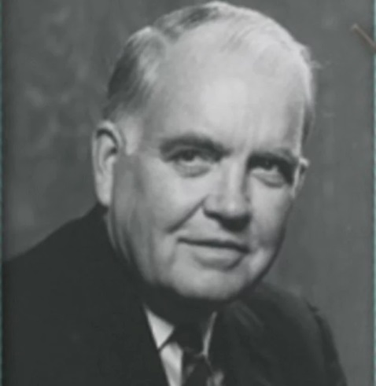
Henry Gadsden, Head of Merck 1968
He wanted Merck to be more like chewing gum maker Wrigley's.
To make drugs for healthy people so that Merck could "sell to everyone."
His dream now drives the marketing machinery of the most profitable industry on earth.“

Slide 26


Slide 27
Thank You

